Slide 1

Project group - aicon
Experience-driven
networking
Kunal Sisodia (6882887)

Slide 2
Outline
Experience-driven
networking
Deep Reinforcement Learning
Traffic Engineering Problem
DRL-TE algorithm
Performance evaluation

Slide 3
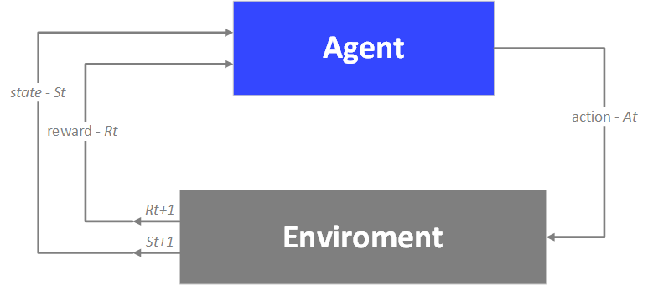
Deep Reinforcement Learning
Paderborn University
Experience-driven
networking
The environment consists of the set of rules which processes the actions of the agent and provides the result.
Action - actions are all the possible task performed by the agent in the environment.
Reward - The reward measures the success, or the failure of the task performed by the agent.
The feedback is provided by the environment for the actions of an agent for any given state.
The results are the new state created and rewards if any
Deep Reinforcement Learning

Slide 4
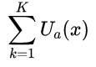
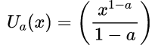
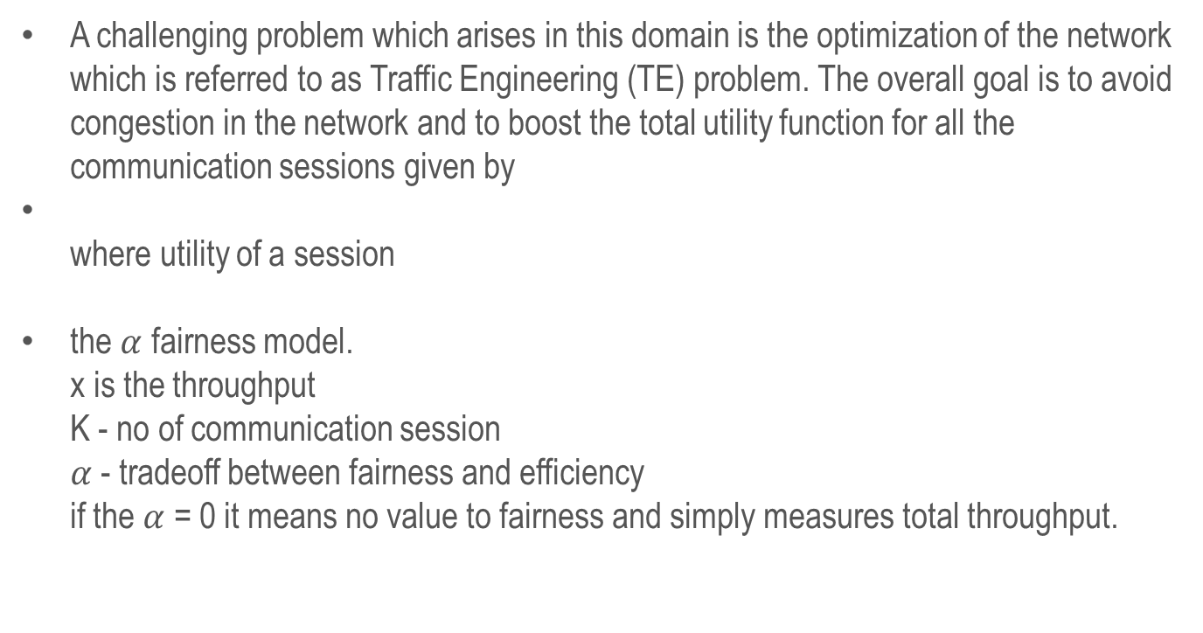
Traffic Engineering Problem
Experience-driven
Paderborn University
networking
In Profile
A challenging problem which arises in this domain is the optimization of the network which is referred to as Traffic Engineering (TE) problem. The overall goal is to avoid congestion in the network and to boost the total utility function for all the communication sessions given by
where utility of a session
the $α$ fairness model. x is the throughput K - no of communication session $α$- tradeoff between fairness and efficiency if the $α$ = 0 it means no value to fairness and simply measures total throughput.

Slide 5
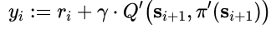
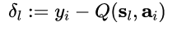
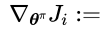
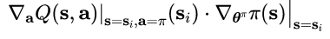
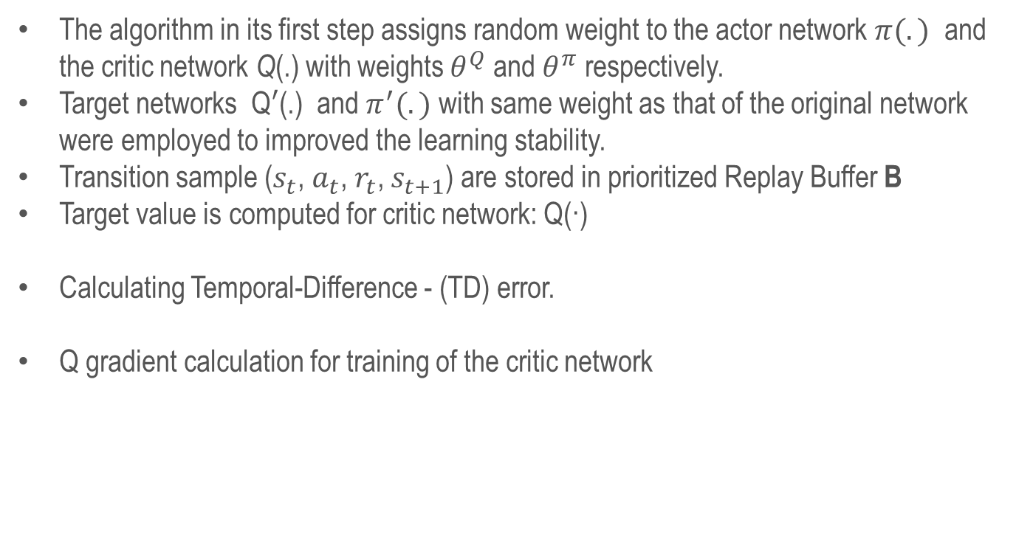
DRL-TE algorithm - Overview
Experience-driven
Paderborn University
networking
In Profile
The algorithm in its first step assigns random weight to the actor network $π(.)$ and the critic network Q(.) with weights $θ^{Q}$ and $θ^{π}$ respectively.
Target networks Q$′$(.) and$π^{′}(.)$ with same weight as that of the original network were employed to improved the learning stability.
Transition sample ($s_{t}$, $a_{t}$, $r_{t}$, $s_{t+1}$) are stored in prioritized Replay Buffer B
Target value is computed for critic network: Q(·)
Calculating Temporal-Difference - (TD) error.
Q gradient calculation for training of the critic network

Slide 6
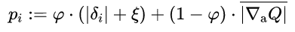
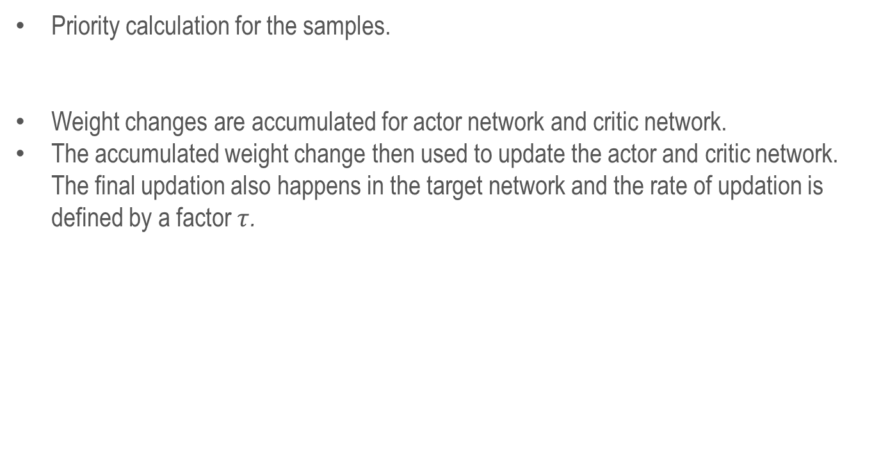
DRL-TE Algorithm conitinued
Experience-driven
Paderborn University
networking
In Profile
Priority calculation for the samples.
Weight changes are accumulated for actor network and critic network.
The accumulated weight change then used to update the actor and critic network. The final updation also happens in the target network and the rate of updation is defined by a factor $τ$.

Slide 7
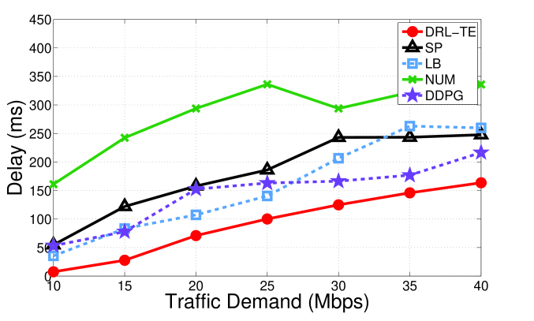
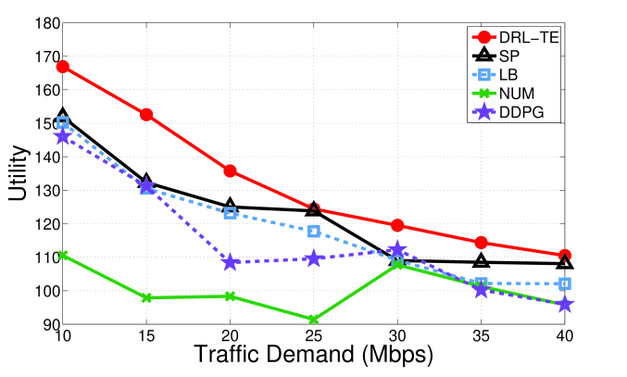
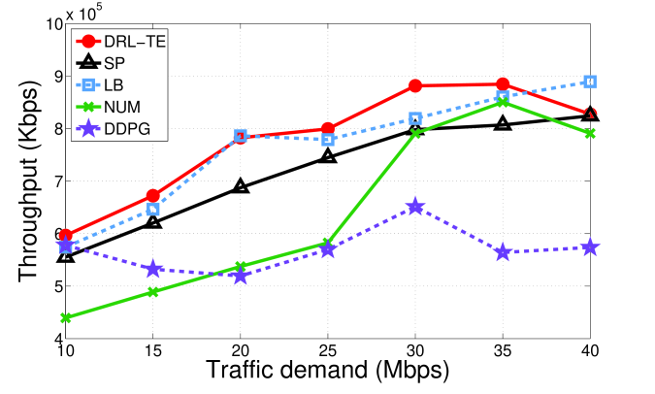
Performance Evaluation
Experience-driven
Paderborn University
networking
In Profile
a) End to End Delay
b) Network Utility
c) End to End Throughput

Slide 8
References
Experience-driven
Paderborn University
networking
In Profile
Z. Xu, J. Tang, J. Meng, W. Zhang, Y. Wang, C. Liu, and D. Yang. “Experience-driven Networking: A Deep Reinforcement Learning based Approach”. In: 2018-April (Oct. 2018), pp. 1871–1879
V. Mnih, K. Kavukcuoglu, D. Silver, A. A. Rusu, J. Veness, M. G. Bellemare, A. Graves, M. Riedmiller, A. K. Fidjeland, G. Ostrovski, S. Petersen, C. Beattie, A. Sadik, I. Antonoglou, H. King, D. Kumaran, D. Wierstra, S. Legg, and D. Hassabis. “Human-level control through deep reinforcement learning”.
S. H. Low and D. E. Lapsley. Optimization flow control. I. Basic algorithm and convergence.

Slide 9

Paderborn University
Experience-driven
networking
Q & A

